Slide 1
Chapter 15: Chemical Equilibrium
Dr. Aimée Tomlinson
Chem
1212

Slide 2
Section 15.1
The Concept of Equilibrium

Slide 3
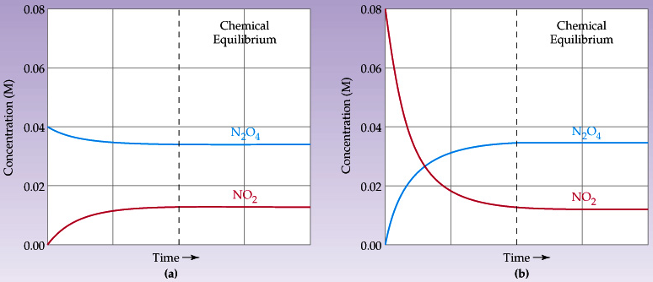
Graphical Representation
After some time:
[N₂O₄] stops decreasing
[NO₂] stops increasing
Solution from clear to brown and back again
Rate_forward = rate_reverse
After some time:
[N₂O₄] stops increasing
[NO₂] stops decreasing
Solution from brown to clear and back again
Rate_forward = rate_reverse

Slide 4

Chemical Equilibrium
Defn: a phenomenon in which the concentrations of reactants and products remain constant over time
NOTE: this does not mean the concentrations go to zero!
X 2

Slide 5
Section 15.2
The Equilibrium Constant

Slide 6
Equilibrium Constant Expression
AKA Law of Mass Action: the chemical equilibrium expression will give rise to a characteristic value for a given temperature
For the General case:
K_{c} is the equilibrium constant in terms of concentrations

Slide 7
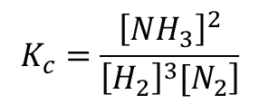
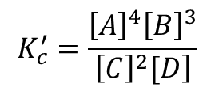
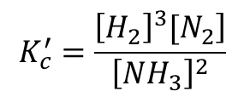
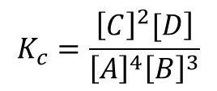
Example
Recall:
Write the Kc for both the forward and reverse directions for the following:
$$K_{c}=\frac{\left.{\left[C\right]}^{2}[D\right]}{{\left[A\right]}^{4}{\left[B\right]}^{3}}$$
$$K_{c}^{′}=\frac{{\left[A\right]}^{4}{\left[B\right]}^{3}}{\left.{\left[C\right]}^{2}[D\right]}$$
$$K_{c}=\frac{{\left[NH_{3}\right]}^{2}}{\left.{\left[H_{2}\right]}^{3}[N_{2}\right]}$$
$$K_{c}^{′}=\frac{\left.{\left[H_{2}\right]}^{3}[N_{2}\right]}{{\left[NH_{3}\right]}^{2}}$$

Slide 8
Mass Action Rule #1
K_{c} in the forward direction is the inverse for the reverse direction

Slide 9
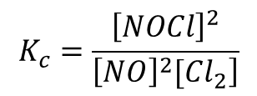
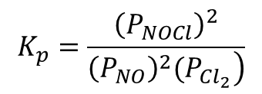
Generalized K_{p}
Example: What is K_{c} and K_{p} for the reaction below.
$$K_{c}=\frac{{\left[NOCl\right]}^{2}}{\left.{\left[NO\right]}^{2}[Cl_{2}\right]}$$
$$K_{p}=\frac{{\left(P_{NOCl}\right)}^{2}}{\left.{\left(P_{NO}\right)}^{2}(P_{Cl_{2}}\right)}$$

Slide 10
How are K_{p} & K_{c} Related?
Using Previous Example:
We start with the ideal gas Law:
Next, we plug into the K_{c} expression

Slide 11
K_{p} & K_{c} Generalized Relationship
Where Δn = moles_{(g)products} - moles_{(g)reactants}
For previous example we had:
So Δn = 3-2 = 1 hence K_{p} = K_{c}RT

Slide 12
Another Example
For which of the following will K_{p} = K_{c}?
So only 2.) & 3.) will work.
X 6

Slide 13
Section 15.3
Understanding & Working with Equilibrium Constants

Slide 14
Judging the Extent of Reaction
K_{c} > 10³ products predominate over reactants:
  reaction proceeds nearly to completion
  very little reactant is left
K_{c} < 10‾³ reactants predominate over products:
  reaction hardly proceeds at all
  very little product is produced
10‾³ < K_{c} < 10³ neither dominates both are present at eq

Slide 15
Handling Combined Equations

Slide 16
Mass Action Rule #2
When adding up equilibrium equations to get an overall the product of their equilibrium constants will give rise to the Kc of the overall equation

Slide 17
Example Problem
Calculate the Kc for
Using the data below:

Slide 18
How does factor multiplication impact K_{c}?

Slide 19
Mass Action Rule #3
Multiplying a chemical by a factor leads to exponential factor for the K_{c}

Slide 20
Summary of Mass Action Rules
ACTION | New Eq Constant
Reversing an eq reaction
Multiplying an eq reaction by n
Adding several eq reactions together

Slide 21
Example Problem
If Kc = 2.4 x 10⁻³ for
what is it for the following?

Slide 22
Section 15.4
Heterogeneous Equilibrium

Slide 23
The Two Types of Equilibria
Heterogeneous
when the reactants/products are in more than one phase
Homogeneous
when the reactants/products are all in the same phase

Slide 24
For Eq we never include:
Solids
Pure Liquids

Slide 25
Section 15.5
Calculating Equilibrium Constants

Slide 26
Finding K with all eq concentrations
What is Kc for the reaction below given the following equilibrium concentrations: [SO₂]=0.15 M, [O₂]=0.68, [SO₃]=1.5

Slide 27
Finding K with initial & eq concentrations
What is Kc for the reaction below given the initial concentrations of reactants were [SO₂]=0.150M and [O₂]=0.680M and the equilibrium concentration of the product is [SO₃]=0.050M?

Slide 28
Finding K with initial concentrations and %dissociation
What is Kc for the reaction below if the initial concentrations for both reactants is 0.500M and they will dissociate by 0.5% to reach equilibrium?

Slide 29
Section 15.6
Application of Equilibrium Constants

Slide 30
Reaction Quotient Q
Q looks just like Kc but it not guaranteed to be at eq

Slide 31
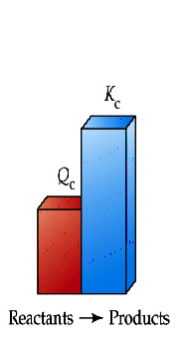
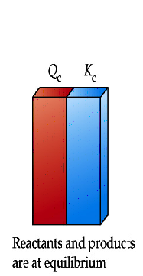
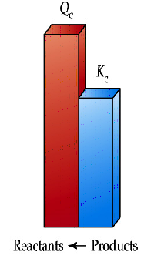
Using Q for Direction Prediction
Need to consume reactants
Go forward
To the right
Toward products
At Eq we go in neither
direction
Need to consume products
Go reverse
To the left
Toward reactants

Slide 32
Example – Practice with Q
Given the data below is the reaction in equilibrium and if not in which direction will need to go in order to reach eq?

Slide 33

Finding Equilibrium Concentrations
We use the "ICE" table:
"I"nitial
"C"hange
"E"q

Slide 34
ICE Example I
The value of K_{c} = 0.0900 at 298K for the reaction below, determine the
eq concentrations if initially [H₂O] = 0.00432 M and [Cl₂O] = 0.00442 M.

Slide 35
ICE Example II
The value of K_{c} for the thermal decomposition of hydrogen sulfide
is 2.2 x 10⁻⁶ at 1400K. A sample of gas in which [H₂S] = 0.600M is heated to 1400K in a sealed vessel. After chemical eq has been achieved, what is the value of [H₂S]? Assume no H₂ and S₂ was present in the original sample.

Slide 36
ICE Example III
What are the eq concentrations of each of the species in the following
reaction, given the K_{c} = 5.1 at 700K and the initial concentration of all
species is 0.050 M?
X 5

Slide 37
Section 13.6-13.9
Le Châtelier’s Principle

Slide 38
Le Châtelier’s Principle
Defn: when a stressor is applied to a system at equilibrium, the system will adjust to counteract the stressor in order to reestablish equilibrium
Stressors include:
Adding or removing reactants or products
Changing the pressure or the volume
Changing the temperature

Slide 39
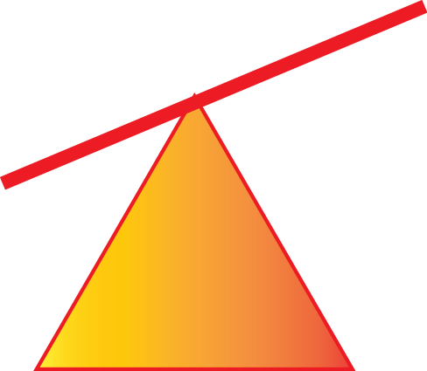
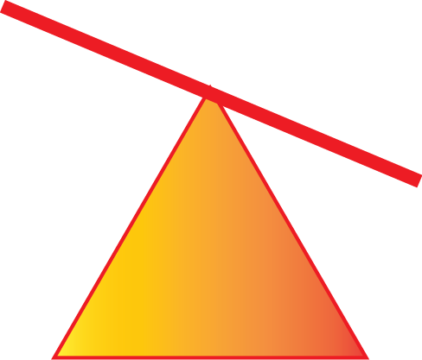
Stressor I: Concentration Changes
Increase in A or decrease in B:
We will need to consume A (or produce B) to get back to eq
We go:
  Forward
  Toward product
  To the right
Increase in B or decrease in A:
We will need to consume A (or produce B) to get back to eq
We go:
  Reverse
  Toward reactant
  To the left

Slide 40
Stressor II: P or V Changes
Decrease V or increase P:
We increase the number of collisions between molecules
  P will increase and V will decrease
  Number of moles appears to increase
We go:
  Forward
  Toward product
  To the right
Increase in V or decrease in P:
We decrease the number of collisions between molecules
  P will decrease and V will increase
  Number of moles appears to decrease
We go:
  Reverse
  Toward reactant
  To the left

Slide 41
LCP Example I
For each scenario predict the direction the reaction goes to attain eq:
a.) CO is added
b.) CH3OH is added
c.) Pressure is reduced
d.) Volume is increased

Slide 42
Stressor III: Temperature Changes
Unique since this stressor will also change the value for K_{c}
For exothermic reaction, heat is a product
Reactants → Products + ΔH
  Removal of heat will force the reaction to go:
    Forward
    Toward product
    To the right
  Addition of heat will force the reaction to go:
    Reverse
    Toward reactant
    To the left
For endothermic reaction, heat is a reactant
ΔH + Reactants → Products
  Addition of heat will force the reaction to go:
    Forward
    Toward product
    To the right
  Removal of heat will force the reaction to go:
    Reverse
    Toward reactant
    To the left

Slide 43
LCP Example II
In what direction will the eq shift when each of the following changes are made to the system at eq?
a.) N2O4 is added
b.) NO2 is removed
c.) Pressure is increased by adding N2
d.) Volume is decreased
e.) Temperature is decreased
X 9

